Slide 1
IRL Buying Policy

Slide 2
The Core Conflict
Buy less to reduce liquidation risk
Limit the Range
Limit NPI risk
Protect Healthy Profitability
Grow sales and Profitability faster
We are losing sales
Stock is growing
Buy more to protect availability
Present more Range
More NPI
Grow Sales
Notes:
Look at the current P&L, YTD we are growing 35% and we are not happy
1. The growth is not fast enough compare to the OE growth
2. Stock is high – and risk the throughput
The risk of every retailer is how much you really sell from what you buy
Our market is the most difficult one since gross margin is very low, we don’t have powerful tools to move the flow
(at fashion market, they can sell everything. They can have 40% discount and still make gross margin)
This is why we must be very sensitive to the buying – to the flow
Because we choose a side in the conflict – grow sales
But now the stock is a the problem, and we are moving to the other side
There is no escape from this conflict!!!
Other than to have the means to improve the flow and the effectiveness of the buying from good to excellent

Slide 3
The Buying Challenge
Risk of over stock & liquidation
Known “Hero's”
Commercial Bet
Best Sellers
How much to buy?
Regular re supply
First Ranging
Regular NPI
Risk of lost opportunity and shortages
The Risk Factor

Slide 4
How we make the decisions?
Risk of over stock & liquidation
Market knowledge
Commercial and opportunity consideration
Market knowledge
Known “Hero's”
Commercial Bet
Market Data
How much to buy?
Best Sellers
Market Data
Market and Stores Data
Market knowledge
Range Targets and commercial considerations
Regular re supply
First Ranging
Regular NPI
Risk lost opportunity and shortages
The Risk Factor

Slide 5
The Current Reality
These decision needed to be taken per SKU, many times per SKU/Stores (2000X100=200,000)
As a result, the majority of the management attention is allocated to operational decision
The risk management is done per SKU and category level

Slide 6
Management attention Focus
Market knowledge
Commercial and opportunity consideration
Risk of over stock & liquidation
Market knowledge
Known “Hero's”
Commercial Bet
Market Data
Best Sellers
Market Data
Level of Management attention
High attention
Market knowledge
Range Targets and commercial considerations
Regular re supply
System managed, low attention
First Ranging
Market and Stores Data
Regular NPI
Risk lost opportunity and shortages
The Risk Factor

Slide 7
Global Risk Management Strategy
We reasonable protect availability of Best Sellers (4-5 weeks cover)
We protect the customer assortment of the Belly, and short term availability (2 weeks cover)
We protect availability of Market “Hero's” as per Management Decision
We must capture the unique market opportunities, and create derivative offering (High Risk - controlled budget Commercial bet)

Slide 8
NPI Consideration
Market demand – The range target reflect the traffic and needed assortment
Vendors mix
Market preference (Hero’s)
Our vendors strategy (which vendor give us the best ROI and retaining margin)
Strategic alliance and derivatives offering
Croma Brand Leadership – New Technology

Slide 9
How we are going to mange
Best Sellers and Belly coverage will be calculate and PO’s recommendations will be done by Symphony
The stock which is Over Cover + SLM (Not Effective) will be calculated as a % from the overall Category stock
Allowed Not Effective % - Actual Not Effective % = OTB for Commercial Bet
Hero special budget when needed – Management approval

Slide 10
The Stock Buckets
Hero Special approved budget
Management call
Open for commercial bet (OTB)
% Budget (From the overall stock)
Related to the flow efficiency of the category
Over cover
Over cover
Best Sellers 4 weeks cover
Related directly to sales
Managed by System
Belly 2 weeks cover
Related directly to sales
Managed by System

Slide 11
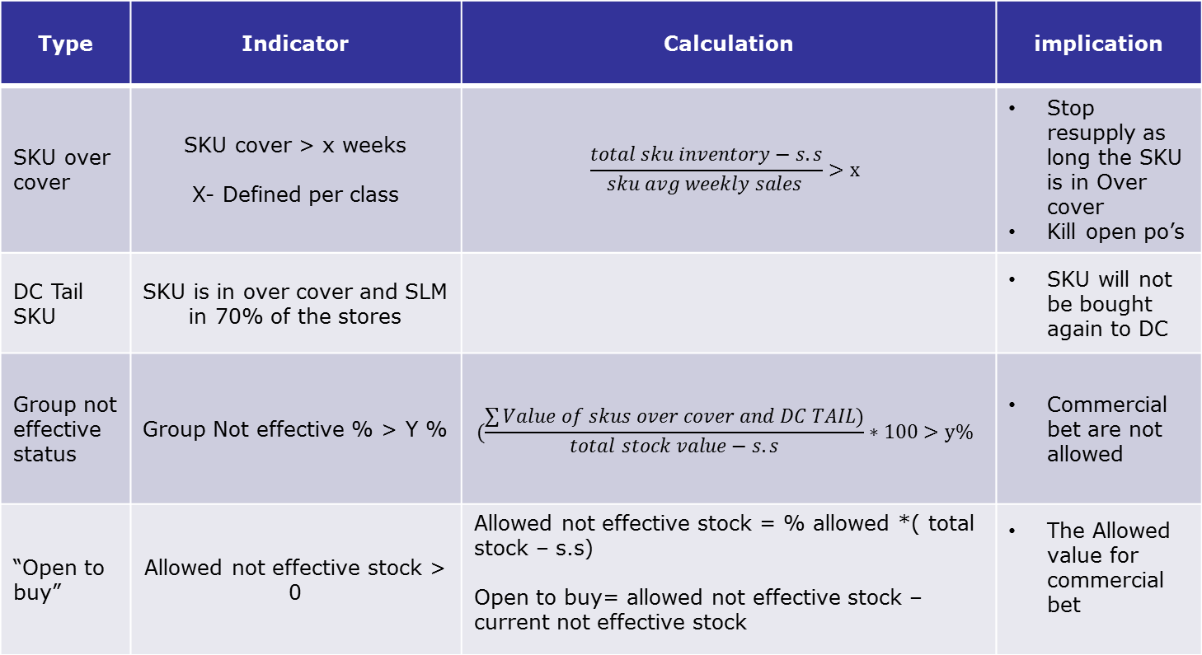
Risk Management Tools
Type | Indicator | Calculation | implication
SKU over cover | SKU cover > x weeks X- Defined per class | $$\frac{total sku inventory−s.s}{sku avg weekly sales }>x$$ | Stop resupply as long the SKU is in Over cover Kill open po’s
DC Tail SKU | SKU is in over cover and SLM in 70% of the stores |  | SKU will not be bought again to DC
Group not effective status | Group Not effective % > Y % | $$(\frac{\sum{Value of skus over cover and DC TAIL)}}{total stock value−s.s}∗100>y\%$$ | Commercial bet are not allowed
“Open to buy” | Allowed not effective stock > 0 | Allowed not effective stock = % allowed *( total stock – s.s) Open to buy= allowed not effective stock – current not effective stock | The Allowed value for commercial bet

Slide 12
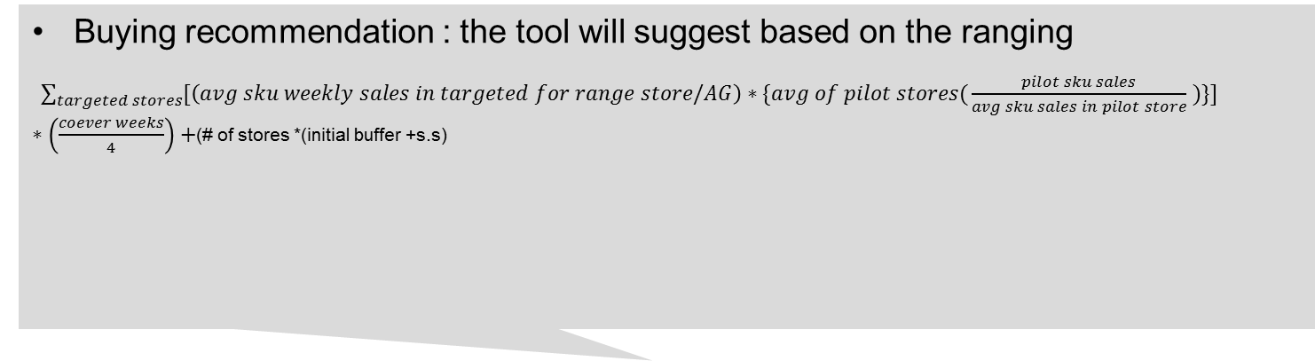
New Product Buying
New product available in the market
Only if the group Not Effective % is lower than permitted
Buying recommendation : the tool will suggest based on the ranging
$\sum_{targeted stores}^{ }{[\left(avg sku weekly sales in targeted for range store/AG\right)∗\{avg of pilot stores(}\frac{pilot sku sales}{avg sku sales in pilot store} )\}]∗\left(\frac{coever weeks}{4}\right)+$(# of stores *(initial buffer +s.s)
Excepted availability problem?
Commercial bet
YES
NO
Buying for pilot
Buying recommendation : NPI tool will suggest quantity for buying:
($\left(\frac{∑\left(avg sku monthly sales per store\backslash AG\right)}{30}∗\# of pilot days\right)+\# of stores∗(s.s+initial buffer )$
Second pilot in lower pb
Liquidate from pilot stores in a discount
If commercial bet, liquidate from wider range of stores in a discount
Pilot
“No Go”
Quantity allowed: the current open to buy budget
Open to buy budget = allowed Not Effective stock in - current Not effective stock
Allowed Not Effective stock = % of allowed not effective stock * current stock (DC+ store- s.s)
“Go”
Buying for the first allocation

Slide 13
Management cockpit
Category | Total Inventory | Group Not Effective % | 4 weeks Inventory Cash Flow | Open To Buy | Commercial Bet | NPI Buying | Resupply Buying | Hero Buying
Laptops | 130 | 23% | -15 | 3 | 4 | 15 | 25 | 1
Phones | 180 | 15% | +30 | 4 | 2 | 20 | 60 | 0
Beginning of the week
Any amount which is higher than Symphony and NPI tool recommendation calculated in the Commercial bet

Slide 14
New Product Buying- Summary
Type/ point of decision | Commercial Bet (avl is an issue) | Hero/Fast Introduction | Regular sku | Rollover
Buying logic | Buy quantity to protect avl | Buy quantity to protect avl and allow fast expansion | Buy only for pilot based on given formula | Buy base on the old sku performance
Limitation | DC Not Effective stock % < X% | Management approval for budget |  | Has to be Similar the old sku
Introduction Process | NPI | Push ranging- within the flexibility limit | NPI | Rollover based on old sku Performance
If “No Go” | Second pilot Range to # number of stores as SLM with significant discount |  | Second pilot Liquidate from pilot stores with significant discount
Buyers and management attention is directed to a limited number of cases that have the biggest effect
All other cases are managed under clear rules

